Slide 1
Light Field Imaging Toolbox

Slide 2
Design goals
Modular
Extensible
Interfaces and implementations
APIs/SPIs... accessible from notebooks or napari
Interoperable
LFMTools (napari plugin)
adapters to ImageJ, ImgLib2, Bioformats,

Slide 3
Modules
design interfaces for the entire workflow, regardless of implemention
LFAcquire (using umgr)
LFMeta, LFData
LFData.import, transform
LFCalibrate
LFRectify
LFDeconvolution
LFDeepLearn, LFInfer
LFView… LFDisplay

Slide 4
Data and Metadata
Metadata
LFMeta specify metadata req'd
LFData + utilizes LFMeta
napari metadata?

Slide 5
???
Leveraging Napari infrastructure…
from PyQt4 import QtCore, QtGui, QtOpenGL… OpenGL
Adapt to VizPy
PyQT4
Adapt to MagicGUI
Acquisition, camera control, drivers → Micromanager?

Slide 6
ImgNav…
Py version of ImgNav... in python?
add subdir organization and metadata/description/notes in file descibeme.
preview image. preview.tif [gif, jpg, png] with tiff [single|multiple page]]?
specify representative thumbnail
like a readme.

Slide 7
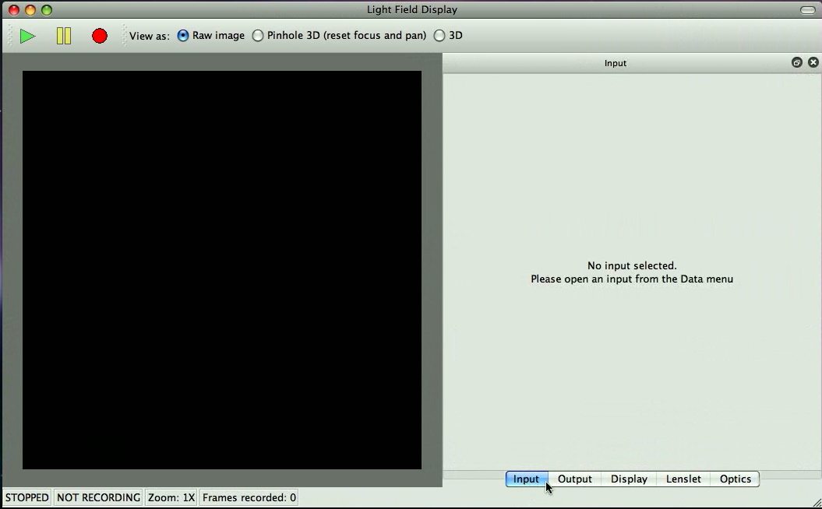

LFDisplay – Main window

Slide 8
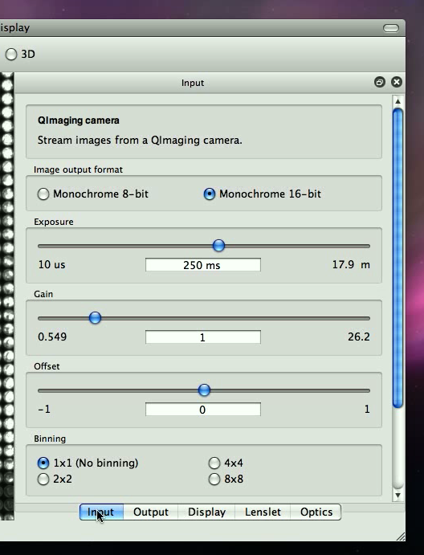
Input
Camera control

Slide 9
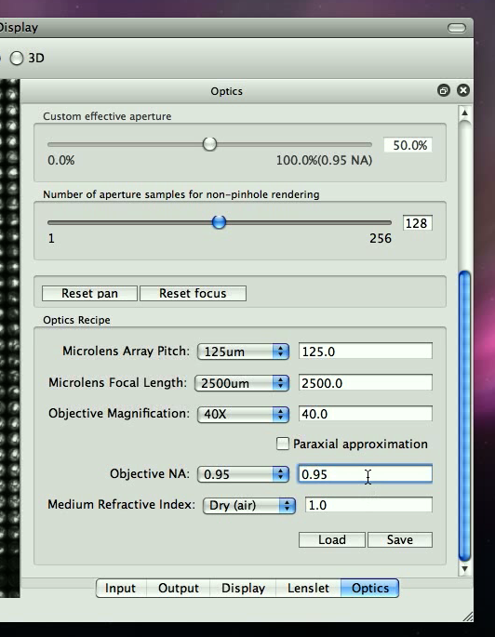
Optics [Config]

Slide 10
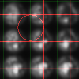
Lenslet

Slide 11
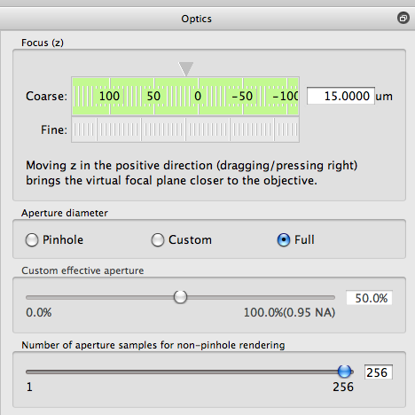
Optics [Explore]

Slide 12
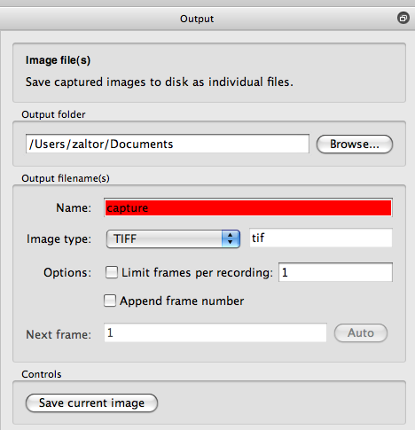
Output9

